Slide 1
International Perspective on Extension Policy
Extension Policy Requirements for Improved Accountability: Programme Planning; Delivery/Implementation; Monitoring & Evaluation
Dr. Kristin Davis, GFRAS
46th Annual Conference of the South African Society for Extension Education, Durban
7 – 11 May 2011

Slide 2
What is Policy?
“…a principle or rule to guide decisions and achieve rational outcomes…”
A statement of intent
Framework for operations and practices
Legal framework
Notes:
part of national development policy in general and of agricultural and rural development policy in particular

Slide 3
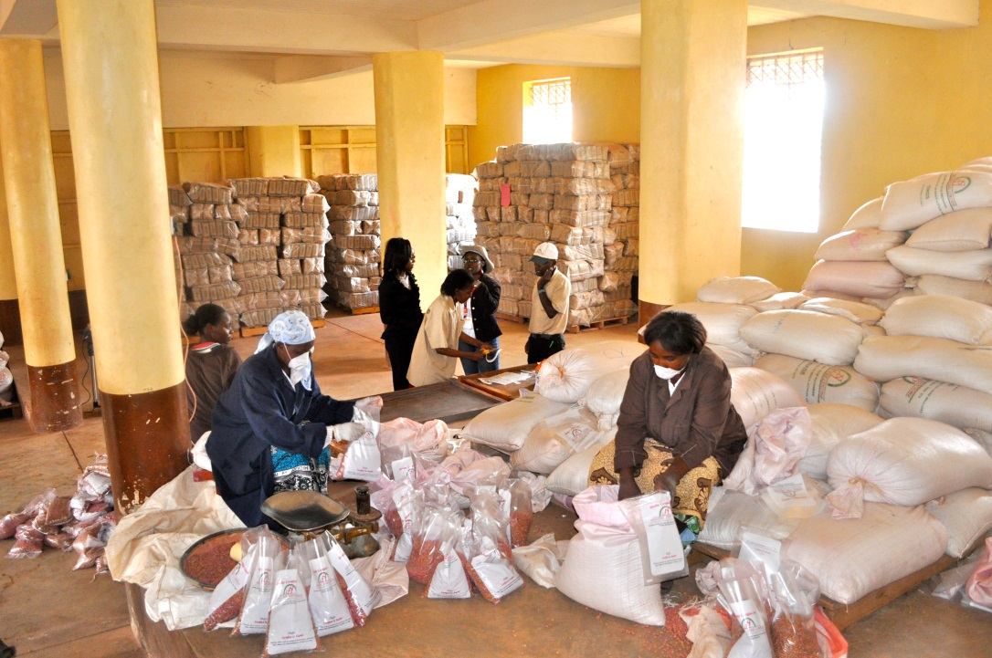
Why Do We Need Policy?
Enact reforms
Provide legal framework
Guide stakeholders
Streamline operations
Incentives!
Source:E. McGaw/FARA
Notes:
Reforms- pluralism, decentralisation, privatisation, etc.
Guide stakeholders- prevent confusion and contradictions
Streamline- know who does what; coordinate with other ministries (education, inputs, credit, research, etc.)
Incentives – especially private sector

Slide 4
Types of Policies*
Provisional
  Not formalised but written (Zambia)
Decrees and proclamations
  Issued by heads of state; no consultation (DRC)
Legislated
  Approved by law-making body (e.g. parliament) (Uganda)
*Oladele 2011
Notes:
South Africa, Lesotho, Swaziland have provisional extension policies
Botswana has legislated extension policy

Slide 5

Policy Examples
  USA’s Smith-Lever Act 1914
  South Africa’s Market-led Agrarian Reform
  Malawi’s fertiliser subsidies
  Kenya’s National Agricultural Sector Extension Policy (NASEP)
Source:E. McGaw/FARA
Notes:
The government is currently implementing the National Agricultural Extension Policy (NAEP) that aims to guide and harmonize management and delivery of extension services in the country (Republic of Kenya, 2004a). The policy advocates demand-driven extension services and preparation of other players in the delivery of extension services. In fact it recognizes the need to diversify, decentralize and strengthen the provision of extra services with a view to increase sustainability and relevance to farms. Under National Agricultural Extension Programme (NALEP), agricultural training in provided by the Ministry
of Agriculture (MOA) and ministry of Livestock and Fisheries (MOLFD) though tertiary training colleges and farmers training centers. Training in agriculture and related fields is also provided at degree levels by public and private universities. Farmers are trained in farmers training centers. Agricultural knowledge, information and technology are provided at the Agricultural Information Center and through agricultural shows. (Kibett 2005)

Slide 6
Policy Worldwide (1)*
Brazil: New Extension Policy PNATER
  Fight Against Hunger
  Social Inclusion
  Sustainable Development
  Family Farming
*Correa da Silva 2011
Notes:
What did they want to do? The following…so they enacted the policy to make it happen

Slide 7
Policy Worldwide (2)
Brazil’s PNATER: Guidelines and Principles
  Pluralism
  Sustainability
  Continuous education
  Gender and equality
  Territorial approach

Slide 8
Policy Worldwide (3)*
Analysis of Policy in Asia
  India
    Prescriptive approach
    Development fads
  China
    Policy weak
    Local-level implementation strong
  Indonesia
    Policy must be accompanied by capacity development!
*Sulaiman and Hall 2005

Slide 9
Policy Worldwide (4)*
Analysis of Policy in Sub-Saharan Africa
  Pluralism dominates
  Only 2 countries have legislated policy
*Oladele 2011

Slide 10
Enacting Extension Policy
  Form expert group to review existing policies, collect data
  Draft document
  Reviews and consultations
  Revision
  Formal approval by ministry
  Final approval by law-making body
Notes:
provides for coordination with research, education, input supply, and credit and marketing systems, as well as some flexibility to reflect the dynamic nature of the agricultural sector. The policy should include the mission and goals for agricultural extension, the responsible agencies and personnel, the clientele to be served, the broad programmatic areas to be addressed, and other relevant guidelines. This should be developed through a multi-stakeholder process; however, the development of extension is dependent on agriculture in most SSA countries which is often tied to government stability and system of government (Contando, 1997).

Slide 11
Enacting Policy: Points to Note
  Vision and mission should guide
  Give guidelines and principles
  Include responsible agencies
  Ensure coordination with research, education, input supply, credit, marketing bodies
  Define clientele
  Include programmatic areas
  Use multi-stakeholder processes

Slide 12
Does Policy Work? Issues
  Role of extension
  Nature of policy process
  Ownership
  Implementation- beyond paper
  Consistency
  Integration
  Political or donor capture
  Monitoring and evaluation

Slide 13
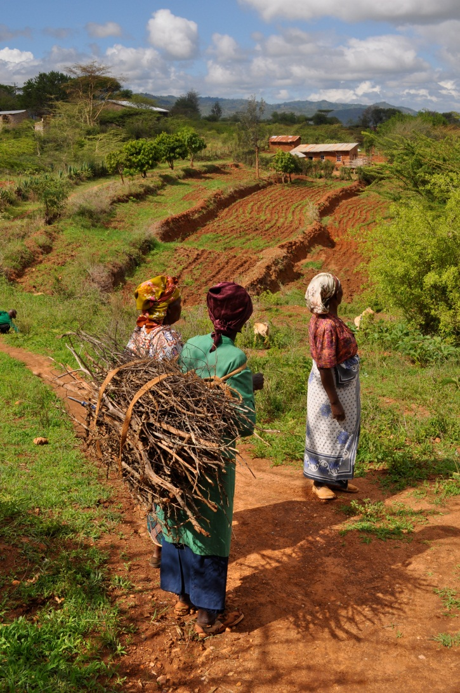
Thank you!
Source:E. McGaw/FARA

Slide 14
References and Resources
  Correa da Silva, H. B. 2011. Innovations in Extension and Advisory Services for Alleviating Poverty and Hunger: Lessons from Brazil. Nairobi International Conference on Extension and Advisory Services. Policy Theme.
  Oladele, O. I. Agricultural Extension Policy: The Missing Link in Innovations in Extension and Advisory Services. Nairobi International Conference on Extension and Advisory Services. Policy Theme. http://extensionconference2011.cta.int/sites/default/files/Extension%20Conference_Abstracts_policy.pdf
  Sulaiman, R. V. and A. Hall. 2005. Extension Policy at the National Level in Asia. Plant Prod. Sci. 8(3): 308-319.
  Swanson and Rajalahti. 2010. Strengthening Agriculture Extension and Advisory Systems: Procedures for Assessing, Transforming, and Evaluating Extension Systems. Agriculture and Rural Development Discussion Paper 45. The World Bank.

