Slide 1

The State of
Food and
Agriculture
2012
Investing in agriculture for a better future
Keith Wiebe and Sarah Lowder
Food and Agriculture Organization of the United Nations
International Food Policy Research Institute
Washington DC, 22 January 2013
Notes:
The State of Food and Agriculture is FAO’s premier flagship publication. It is one of the oldest global reports in the UN system, in production since 1947.
The State of Food and Agriculture carries a special report each year on a major theme in world agriculture, from the perspective of food insecurity and poverty.
This year’s report focuses on how we can invest in agriculture for a better future.
Parts of the 2012 report were prepared in close collaboration with the International Food Policy Research Institute (IFPRI).
IFAD has provided financial support and inputs to the report. Financial support was also provided by the Government of Japan (through the project on “Support to Study Appropriate Policy Measures to Increase Investment in Agriculture and Stimulate Food Production”).

Slide 2
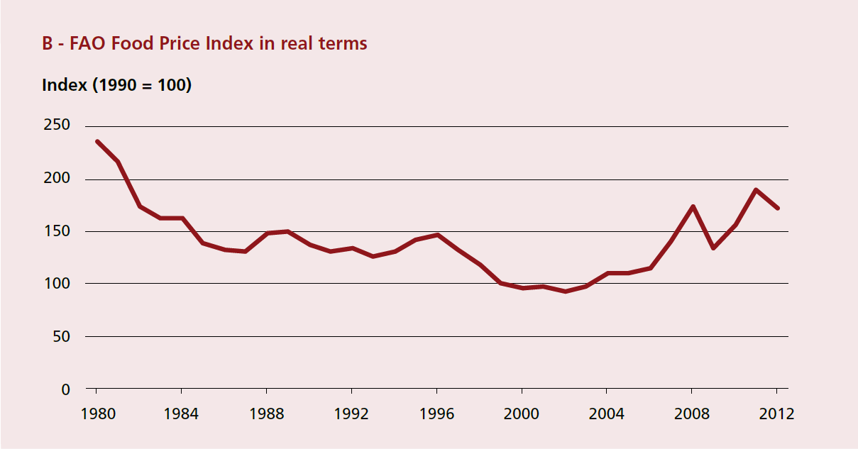
Higher prices have renewed attention to agriculture
Source: FAO

Slide 3
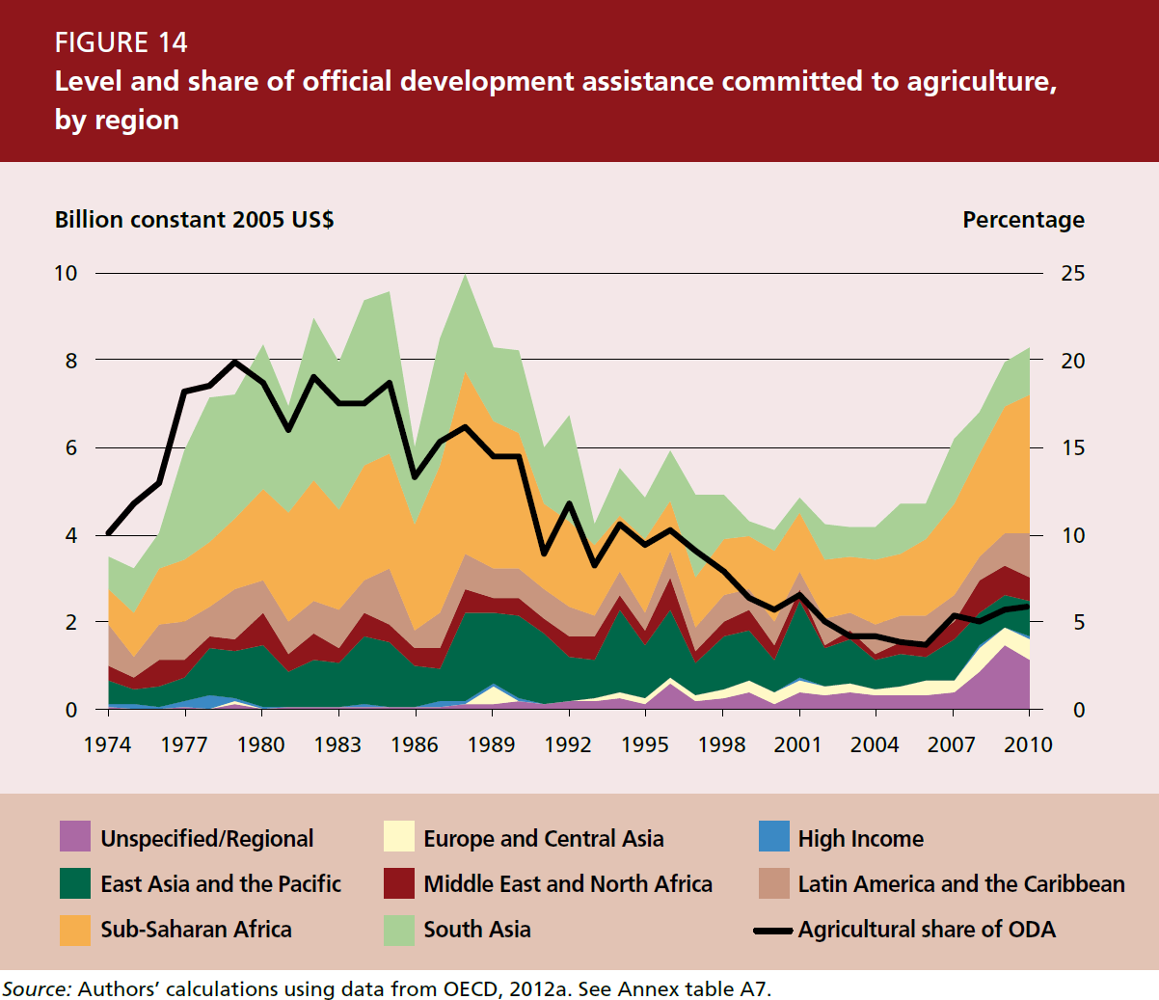
ODA to agriculture has followed price trends

Slide 4
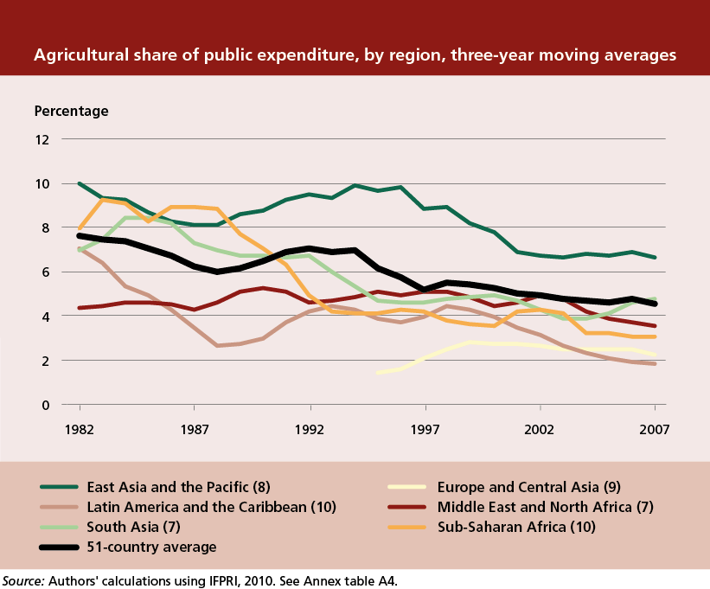
Agriculture has also declined as a share of domestic public expenditures
Notes:
Government investments in agriculture are smaller in magnitude than those by farmers. However, they are very important. Public investments in public goods are complementary to private investments. They constitute an essential component of creating an enabling environment for farm investments.
Over time, governments have been spending a declining share of their budgets on agriculture. This is shown by the graph for several regions.
Often, the decline has been even sharper than the decline in the share of agriculture in overall GDP.
The declining share of agriculture in public expenditures is generally the result of increases in other areas with a significant development impact: education, health, social expenditures.
Increasing the share of agriculture in total public expenditures may not be straightforward, as it means cutting back elsewhere. It is therefore very important to enhance the effectiveness of agricultural expenditures and focus them on areas with the largest impact.

Slide 5
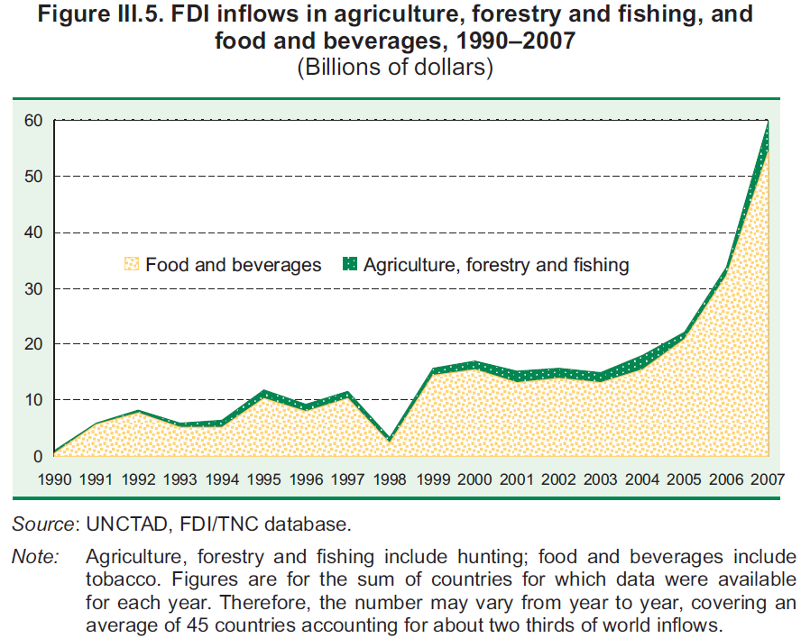
(WIR 2009)

Slide 6
FDI is increasing, but …
Total FDI in 27 countries averaged $922 billion per year in 2007-08
  6 percent to food and agriculture
  5.6 percent to food, beverages and tobacco, mostly to high-income countries
  Only 0.4 percent to agriculture
FDI in agriculture in 44 countries averaged $5.4 billion per year in 2007-08
  More than double the level in 2005-06
  78 percent was to upper-middle-income and high-income countries

Slide 7
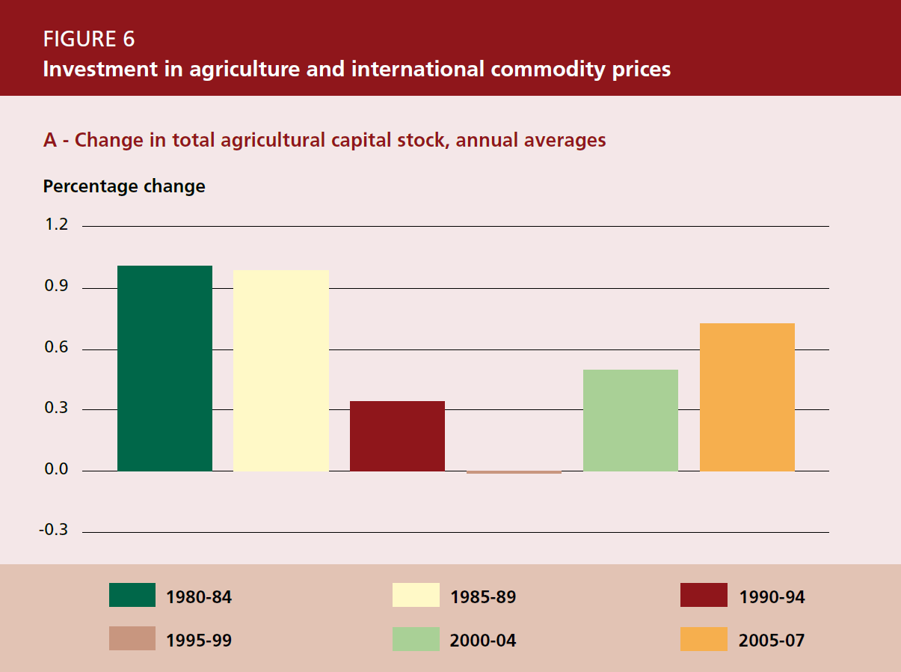
On-farm investment has followed a similar pattern
Source: Authors’ calculations using FAO 2012a

Slide 8
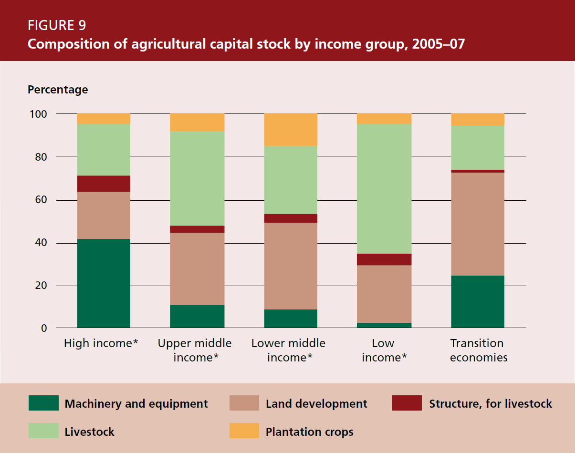
The composition of on-farm capital varies

Slide 9
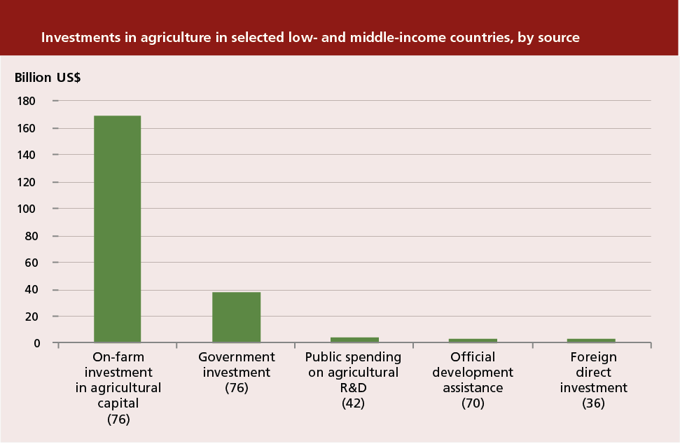
Farmers are the largest investors in agriculture
Source: Lowder, Carisma and Skoet, 2012.
Notes:
Who invests in agriculture and how much?
Limited data availability is a major problem. No set of internationally comparable data allows a complete estimate of agricultural investments by different type of investor.
We have looked at different datasets that shed some light on different dimensions of investment in agriculture:
Agricultural capital stock. (FAO Statistics Division) The value of on-farm capital: machinery and equipment, livestock, buildings, permanent crops, improved land. The change in capital stock represents (net) investments by farmers. (We have assumed a depreciation rate of 5% to arrive at gross investment).
Government expenditures on agriculture. (IFPRI). Only part of this represents investment (we have assumed 50% based on a survey of public expenditure reviews).
Public spending on agricultural R&D (Agricultural Science and Technology Indicators – source: IFPRI).
Official development assistance (OECD)
Foreign direct investment (UNCTAD)
We compare these different investments for a subset of countries. This does not provide an exact estimate of the size of these different flows, but gives an indication of the relative order of magnitude of the different investment sources.
Farmers are by far the largest investors in agriculture (column 1). Their investment is more than four times that of public investment (columns 2 and 3). This is probably a conservative estimate, as several types of investments by farmers may not be included.
In spite of much attention to ODA and FDI (last two columns), these sources of investments are dwarfed by farmers’ investment.
The implication of this is clear:
Farmers must be central to any strategy for increasing investment in agriculture.

Slide 10
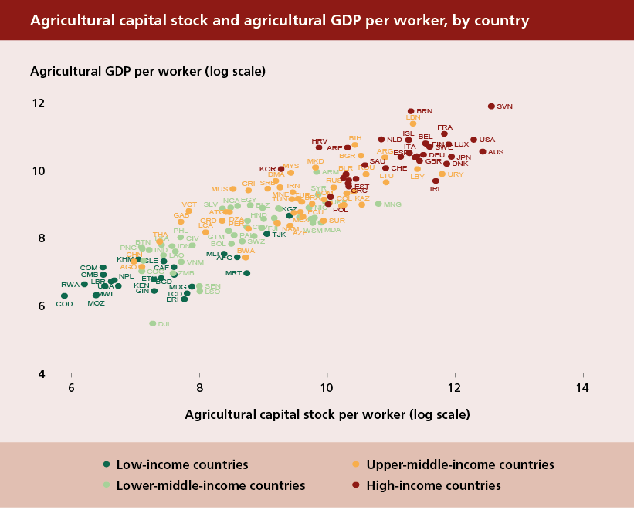
Investing in agriculture raises productivity
Source: FAO, 2012a.
Notes:
Investments by farmers are crucial to raising their labour productivity and farm incomes.
The figure shows a strong relation between two important indicators:
Agricultural capital stock per person employed in agriculture (the first axis) – the capital-labour ratio in agriculture
Agricultural GDP per worker (the second axis)
The figure cannot establish the direction of causality. But the two are clearly highly correlated and rise markedly with overall per capita income levels.
Broadly speaking, low-income countries have low levels of agricultural capital per worker and correspondingly low levels of agricultural output per worker.
For countries with low levels of productivity, increasing agricultural productivity involves increasing capital-labour ratios by investing in agriculture.
What we would expect to see is countries moving gradually from the bottom left towards the top right of the graphic.

Slide 11
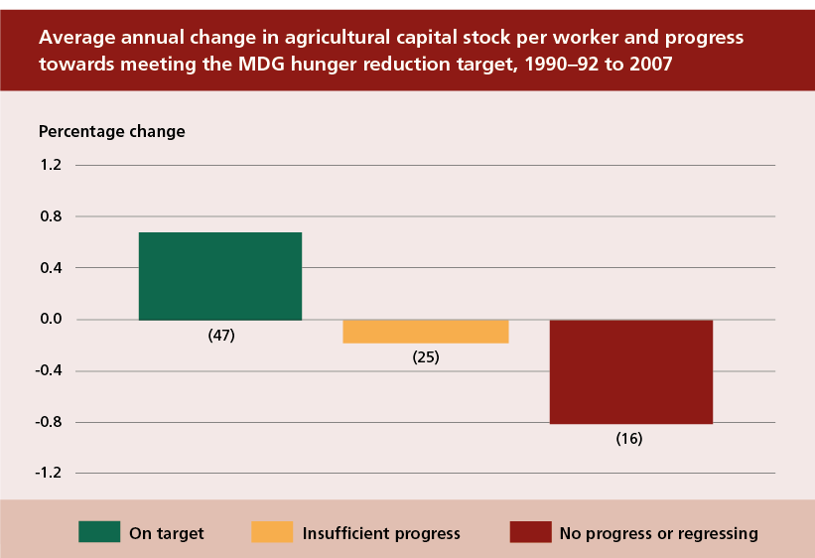
Investing in agriculture reduces hunger
Source: Authors’ calculations using FAO, 2012a and FAO, IFAD and WFP, 2012.
Notes:
There is a close link between agricultural investments and progress in hunger reduction.
The graphic shows average changes in farm capital per labourer since 1990.
The change is shown for three groups of countries, according to their progress towards the MDG 1c, which is to halve the proportion of people suffering from hunger between 1990 and 2015:
Those that are on track to meet the target – in green
Those that have made insufficient progress – in yellow
Those that have made no progress or regressed – in brown
(The classification is based on The State of Food Insecurity in the World 2012.)
Countries on target have increased their capital-labour ratios.
Countries making insufficient progress have experienced a slight decline.
Countries making no progress have experienced a significant decline.
More investment in agriculture is needed to feed a growing world population and eradicate hunger.

Slide 12
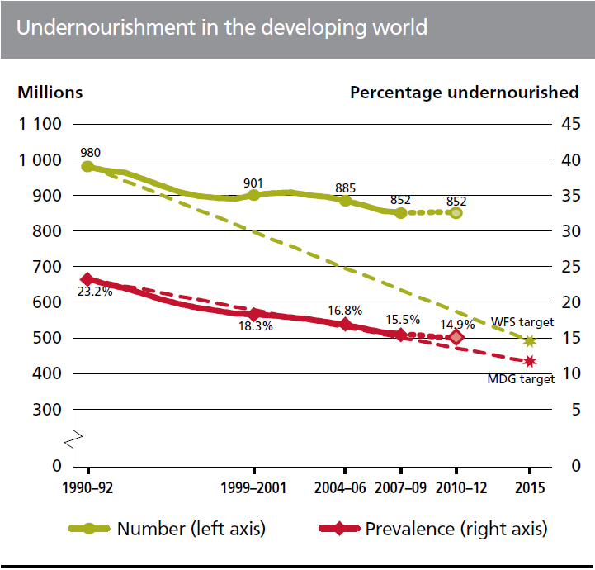
Progress in reducing hunger has slowed
Source: FAO (SOFI 2012)

Slide 13
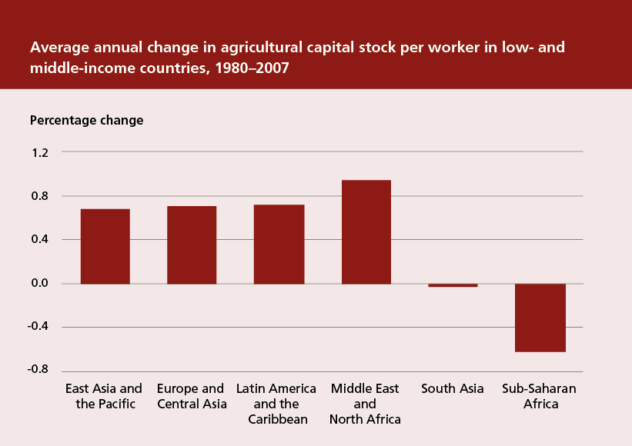
Investments are too low in regions that need them most
Source: Authors’ calculations using FAO, 2012a and World Bank, 2012.
Notes:
The graph provides a regional perspective. It shows the average annual increase in capital stock per labourer for different regions since 1980.
In sub-Saharan Africa, the capital-labour ratio has been declining. This is not because there has been no investment in agriculture. Actually, agricultural capital grew at an average annual rate of 1.5 percent. But the number of people employed in agriculture increased even more.
A similar picture emerges also in South Asia. These regions have a high incidence of hunger. Boosting agricultural productivity is crucial for accelerating hunger reduction.
This only shows regional averages. Within regions, there are countries that have increased their capital-labour ratios in agriculture and countries that have not.
Other analysis (not shown here) indicates that countries with low initial levels of capital stock per labourer have tended to see these decline further.
In too many countries worldwide farmers have not invested enough to increase their labour productivity.

Slide 14
Hunger by region, 1990–2012
Source: FAO (SOFI 2012)

Slide 15
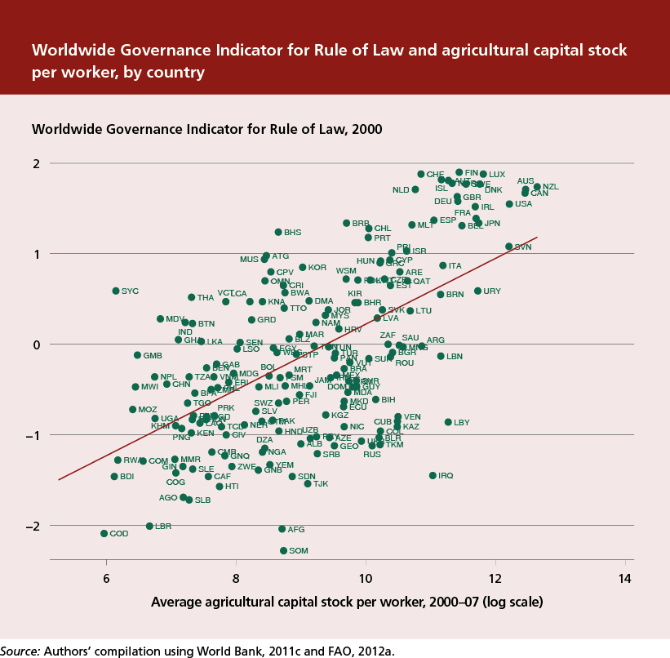
The investment climate is critical
Notes:
Farmers will not invest adequately, unless governments help ensure a favourable climate for agricultural investments.
Various factors often increase the cost and risks of investing in agriculture: poor governance, absence of rule of law, high levels of corruption, insecure property rights, arbitrary trade rules, taxation of agriculture relative to other sectors, failure to provide adequate infrastructure and public services in rural areas and waste of scarce public resources.
All these can contribute to reducing the incentive to invest in agriculture.
The graphic shows the relation between agricultural capital stock per worker (first axis) and World Governance Indicator of Rule of Law (prepared by the World Bank). (Comparable patterns also emerge for other governance indicators, such as the Corruption Perception Index compiled by Transparency International and the Political Risk Index of the Political Risk Services Group.)
These relationships only show correlations and are not very specific. But they suggest that the elements of good governance that are necessary for overall investment in an economy are equally important for agriculture.

Slide 16
Improved governance is a key element
Voluntary Guidelines on the Responsible Governance of Tenure
  Endorsed by the CFS in May 2012
Principles for Responsible Agricultural Investment
  Land and resource rights
  Food security
  Transparency and good governance
  Consultation and participation
  Economic viability
  Social sustainability
  Environmental sustainability

Slide 17
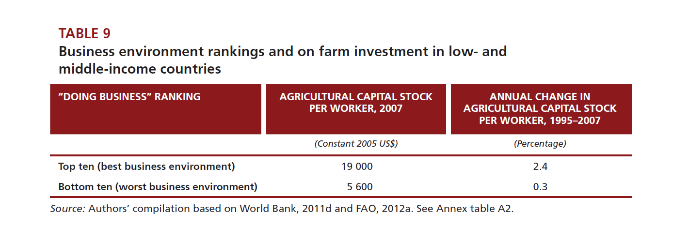
Good business environments are associated with more investment
Source: Authors’ calculations using FAO, 2012a and World Bank, 2011b.
Notes:
Beyond broad governance, factors that affect the ease of doing business in a country also appear to be important for agricultural investments.
The table is based on the World Bank’s country rankings for ease of doing business. It shows the top and the bottom ten countries in the ranking among the low- and middle-income countries. The top ten countries have three times as much agricultural capital stock per worker as the bottom ten. Furthermore, the rate of growth in agricultural capital per worker since 1995 was eight times faster than for the top ten.
These are only broad relations and they generally refer to an urban business environment.
It is important to gain a better understanding of what contributes to a more specific investment climate for agriculture and rural areas and to develop more specific indicators for this.

Slide 18
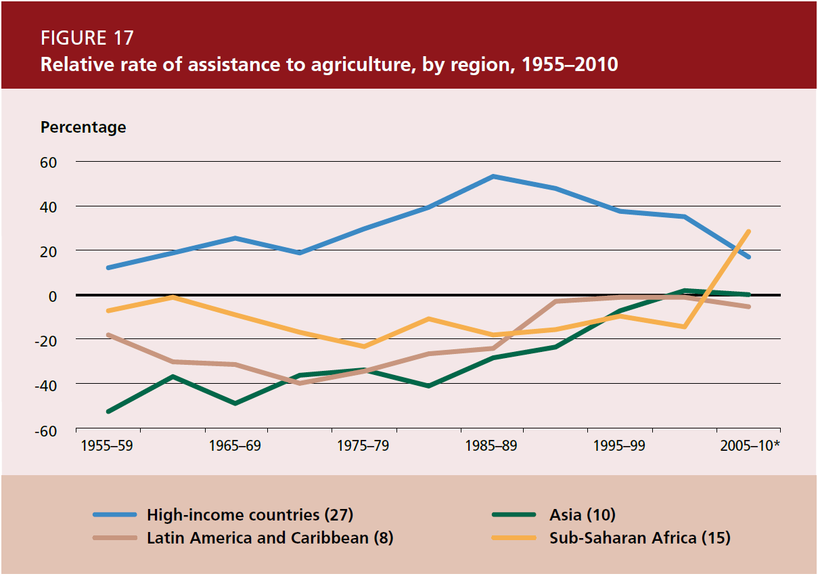
Policies are also important

Slide 19
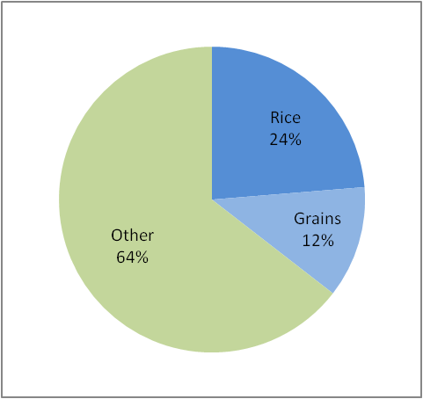
Monitoring policy impacts: rice in Mali
Large share of ag budget
… but policies provide price disincentives to producers
Source: MAFAP
Source: MAFAP

Slide 20
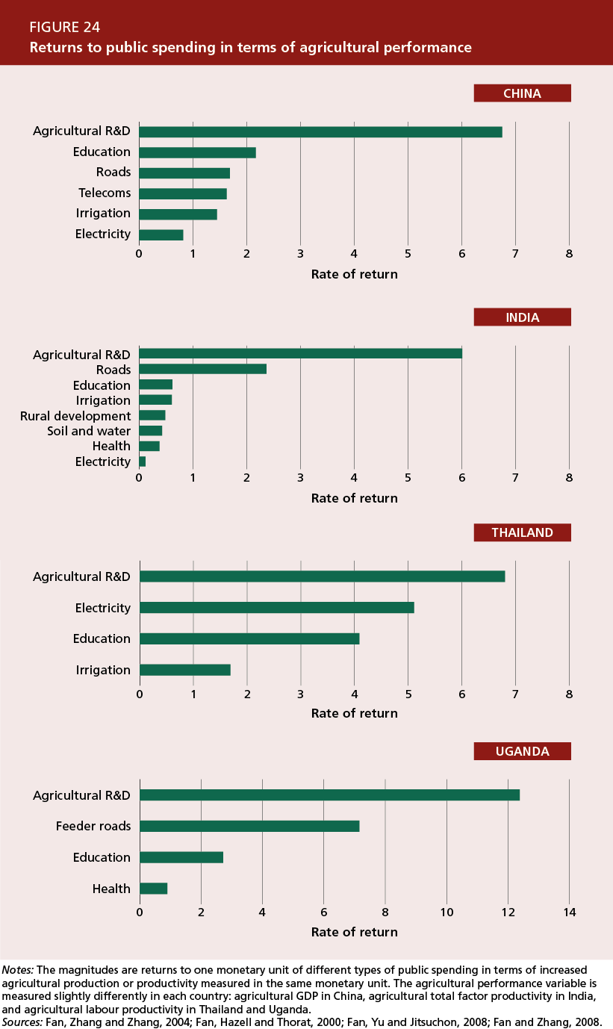
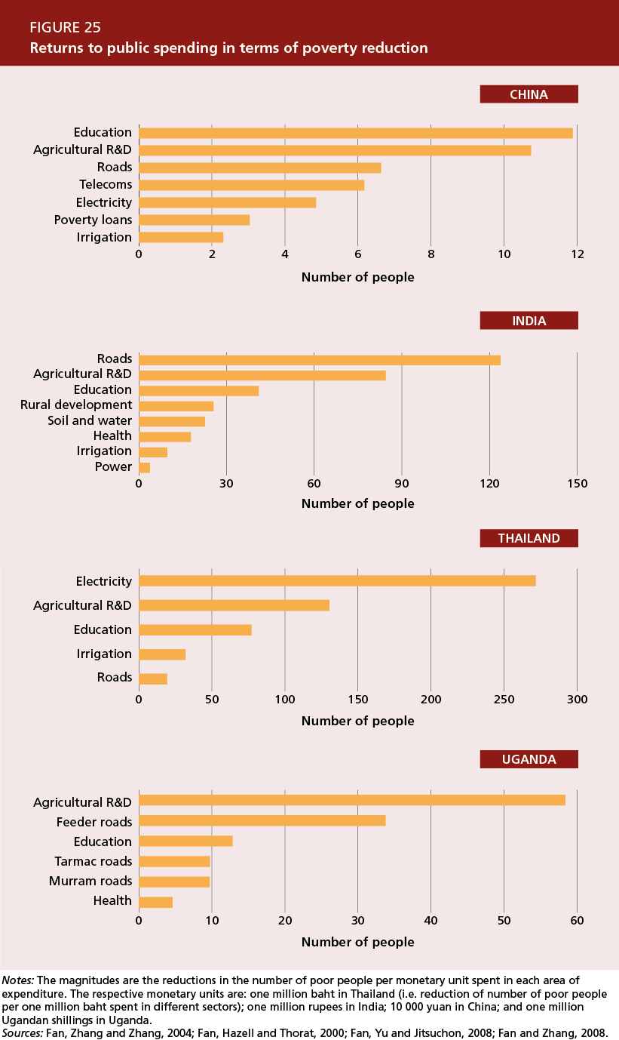
Governments must focus on public goods with large impacts
Source: Fan, Zhang and Zhang, 2004.
Notes:
Some government expenditures are better than others in terms of enhancing agricultural growth, productivity and poverty alleviation. Investments in key public goods such as agricultural research, rural roads and education have a high impact – both in terms of agricultural growth and poverty reduction. This is illustrated by the graph for China.
By focusing on public goods, governments can enhance the impact of public expenditures. Of course, the relative impacts of different types of public investments differ by country and location. Therefore investment priorities must be locally determined. Gaining sufficient empirical evidence on the impact of different types of investment is a crucial, but difficult, challenge.
However, one type of investment that has been found to have consistently high returns in all contexts is investment in agricultural R&D.

Slide 21
Key messages
Investing in agriculture is one of the most effective strategies for reducing poverty and hunger
Farmers are the largest investors in agriculture, and must be central to agricultural investment strategies
A favourable investment climate is necessary but not sufficient
  small farmers need special assistance to overcome barriers
  large-scale investments need special attention to ensure broad and sustainable benefits
Governments must focus on public goods with high social returns
An improved evidence base is essential

Slide 22
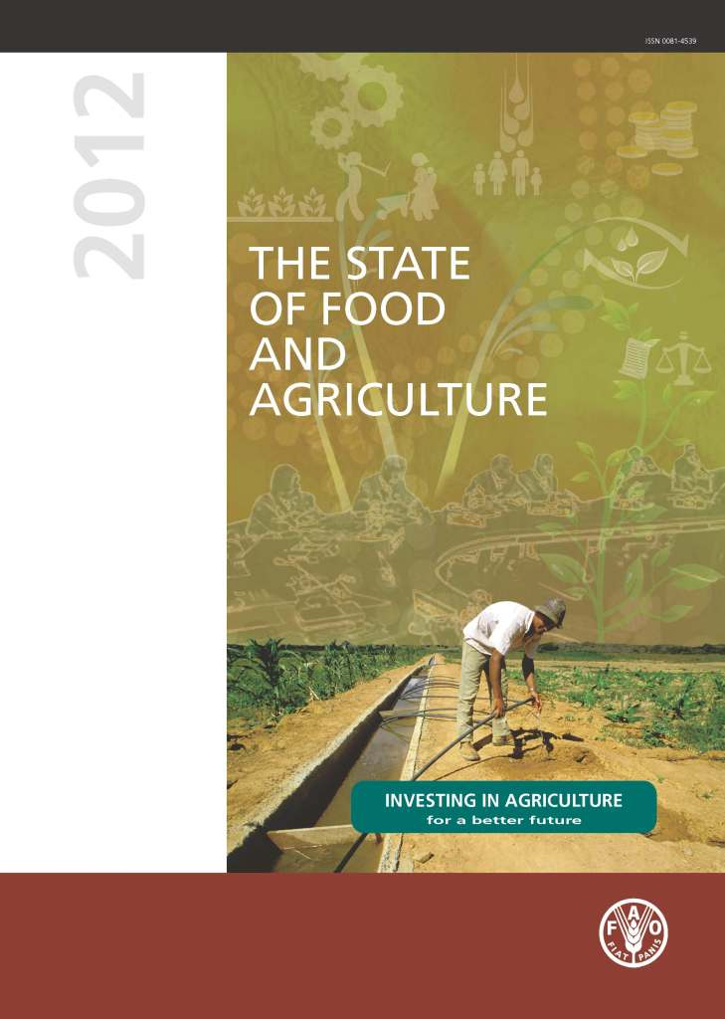
For more information
The State of
Food and Agriculture
Investing in agriculture
for a better future
FAO‘s flagship publication.
Available in English, French, Spanish, Russian, Arabic and Chinese
www.fao.org/publications/sofa

