Slide 1
Development and Validation of Liberia’s National Policy for Agricultural Extension and Advisory Services (AEAS)
Vickie A. Sigman Consultant, Modernizing Extension and Advisory Services Project, University of Illinois, Urbana-Champaign
Thomas Gbokie, Jr. Deputy Minister, Department of Regional Development, Research & Extension, Ministry of Agriculture, Liberia
Moses M. Zinnah Director, Program Management Unit, Ministry of Agriculture, Liberia
Ousman Tall Assistant Minister, Department of Planning & Development, Ministry of Agriculture, Liberia
Notes:
IF NOT INTRODUCED THEN: Good Afternoon. The title of our presentation today is “Development and Validation of Liberia’s National Policy for Agricultural Extension and Advisory Services”. My name is Thomas Gbokie, Deputy Minister of Regional Development, Research & Extension at the Ministry of Agriculture in Liberia. I am pleased to introduce my colleague, Dr. Vickie Sigman, from the MEAS project, U of Illinois. It is good to see everyone. Thank you for coming to our presentation.
OTHERWISE: Thank you. Nice to see everyone. Thank you for coming to our presentation.

Slide 2
Introduction
Begin with some definitions:
Policy
principle or rule to guide decisions and achieve rational outcomes (Wikipedia online)
a course or principle of action adopted or proposed by an organization or individual (Oxford Dictionaries online)
Public Policy
An intentional course of action followed by a government institution or official for resolving an issue of public concern (Cochran, Mayer, Carr, & Cayer; 2009).
Notes:
Let’s begin today with some definitions.
Policy is …
And public policy is…: In our case, the institution of interest is Liberia’s Ministry of Agriculture and the issue of public concern is the development, delivery, M&E of agricultural extension and advisory services.

Slide 3
Policy Cycle
Builds on Lasswell’s work*
Not without critics & variations in stages but typically includes:
Problem Definition/Agenda Setting
Formulation
Implementation
Evaluation
Source: Adapted from Sutcliffe & Court (2006); Pollard & Court (2005).
*as cited in Nakamura, 1987; Pollard & Court, 2005.
Notes:
The discussion today is framed by the stages in the Policy Cycle. The Policy Cycle builds on Lasswell’s work, a political scientist who wrote extensively on how to improve the policy-making process. The Policy Cycle is not without its critics but typically the cycle includes these basic elements:
Problem Definition/ Agenda setting: where the problem to be addressed (or not) is defined and getting the problem on the political agenda is achieved.
Formulation: a time of analysis and fact-finding, where policy options are identified and preferred options selected
Implementation: this is where the policy is executed and
Evaluation: where the effectiveness and impact of the policy is monitored and evaluated, feedback obtained, and the policy reformulated as needed.
Today we are looking at Liberia’s experience in light of the policy cycle. Most of the presentation today focuses on thee first two stages although some implementation issues will be discussed. Lessons learned from the experience will also be presented.

Slide 4
Problem Identification: Context
Policy Cycle Stage 1: Problem Identification/Agenda Setting
Post-conflict country
Decades of mismanagement
14 years of brutal civil war
President Ellen Johnson Sirleaf (since 2006) moving forward
Agriculture sector
Close to 3/4ths of population of 4 million engaged directly or indirectly in smallholder subsistence agriculture
Reliance on food imports
Yields low; post-harvest losses high; value chains underdeveloped; institutions weak
Notes:
Looking at Policy Cycle Stage 1, problem identification is set in the context of the situation in Liberia.
Post-conflict country
Recovering from decades of mismanagement and 14 years of brutal civil war – which devastated the country
President Ellen Johnson Sirleaf moving the country forward since 2006
Close to 3/4ths of 4 million population engaged directly or indirectly in smallholder subsistence agriculture
Heavy reliance on food imports
Ag yields low; post-harvest losses high; value chains severely underdeveloped; agricultural institutions (such as extension, education, research) are weak

Slide 5
Problem Identification: Context
AGRICULTURAL EXTENSION
Virtually no extension during time of armed conflict
Public system completely collapsed
Civil society began providing services as conflict came to an end
Current status
Rebuilding public system – challenged by lack of
Improved profitable technologies and practices
Client-input into extension processes
Adequate human, infrastructural, institutional capacities
Sufficient funding
Many NGOs, limited private sector
Uncoordinated, fragmented, duplicative services of varying quality with limited reach
Notes:
Overall, current system is uncoordinated and fragmented, there is a duplication of services of varying quality with limited reach

Slide 6
Problem Definition
Problem Defined: Lack of effective, efficient extension and advisory services to respond to the needs of smallholders
Notes:
At its most basic, the problem the policy is to address is defined as:

Slide 7
Agenda Setting
Problem
Recognized by Government in its post-conflict development agenda – considers centrality of agriculture to recovery, calls for transformation of the extension services
Noted by President Sirleaf – tasked Cabinet with timely development of key agricultural policies including AEAS policy
EAS was on the political agenda
EAS policy development initiative was part of response to the agenda
Notes:
The problem identified is recognized by Liberia’s Government in its post-conflict development agenda which considers the centrality of the development of the agriculture sector to recovery and calls for transformation of the extension services
Noted by President Sirleaf who tasked members of her Cabinet with the timely development of key ag policies including an AEAS policy
In effect, at the time Liberia’s policy was developed, it was already on the political agenda. Development of the policy was part of the response to the agenda.

Slide 8
Policy Cycle Stage 2: Formulation
In Liberia, formulation
began in 2009 with a first draft of an EAS policy
new initiative in 2012 to finalize policy development
initiative – supported by Ministry of Agriculture (MOA) and donors - involved key actions and key decisions
Notes:
Policy Cycle Stage 2 is Formulation. In Liberia, …

Slide 9
Key Actions
1. Appoint Task Force to lead process and Facilitator to support Task Force (MOA/USAID/FED)
Learning activities to strengthen policy capacity of Task Force
2. Obtain additional input from stakeholders
MOA written request; individual/group meetings; e-mail survey; field visits
3. Discuss and debate merits of policy options
4. Draft and revise policy (iterative process)
5. Hold Stakeholder Validation Workshop
6. Produce final draft policy document (incorporate input)
Notes:
Appoint a Task Force to the lead the process and a Facilitator to support the Task Force. Task Force comprised of senior MOA officials, representatives from the large-scale USAID funded Food and Enterprise Development project, and a consultant facilitator.
An initial activity was to strengthen the policy capacity of the Task Force. Accomplished through a set of
Learning activities involving investigating policy definitions and the purpose of policy; examining Global trends in AEAS to better understand the latest policy options; and scrutinizing AEAS policies from other countries to learn what was being done in similar situations;
IN LIGHT OF THIS LEARNING,
The 2009 draft was analyzed to identify areas to be strengthened.
Obtain additional input from stakeholders (stakeholders are further discussed in following slides: we used a variety of means to obtain input – MOA sent a written request for input from ministry staff and others in government, individual and group meetings were held, an e-mail survey of a wide-range of stakeholders was conducted, and various field visits were made.
There was lively discussion and debate of the merits of policy options
The draft of the policy was revised several times based on dialogue and input
A key action was holding the Stakeholder Validation Workshop. This workshop engaged a very wide-range of stakeholders who provided substantive input to the policy development process. This resulted in producing a final draft of the policy document.

Slide 10
AEAS Stakeholders Consulted
Farmers
Notes:
A wide-range of stakeholders provided input to the policy development process. These included:

Slide 11
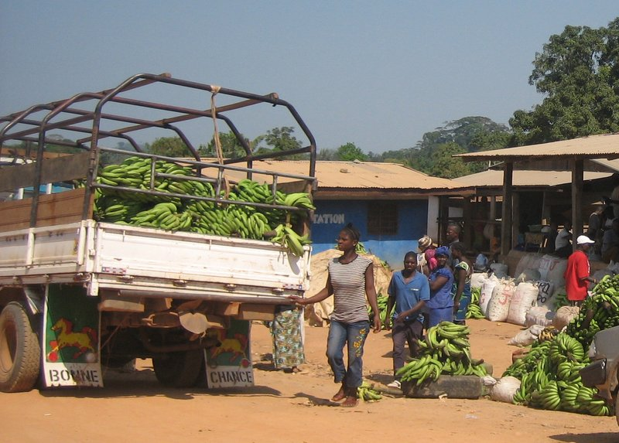
AEAS Stakeholders Consulted
Traders & others in private sector business community
Young people studying for careers in ag

Slide 12
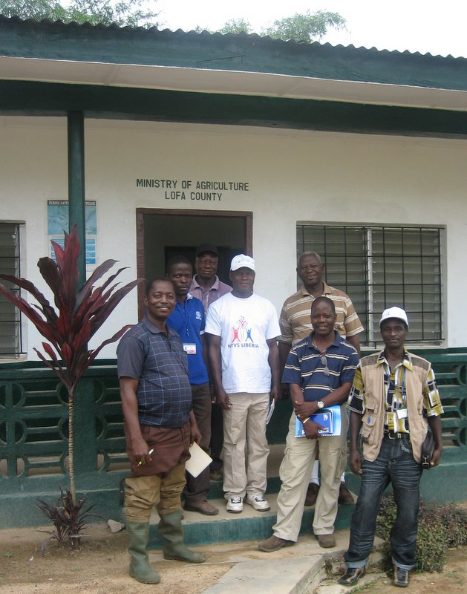
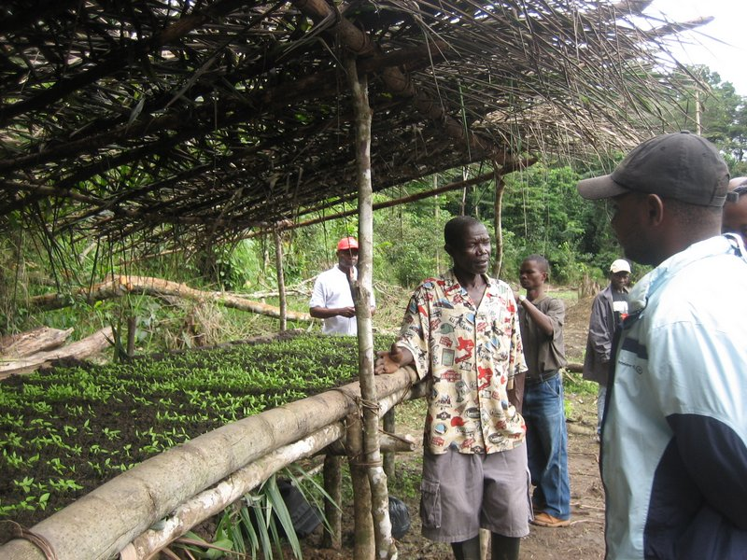
AEAS Stakeholders Consulted AEAS Providers (Public, Private, & Civil Society)
Additional stakeholders: agriculture educators, financial community members, local government authorities, and legislators.
Notes:
And of course AEAS providers from public, private, and civil society sectors. Also input was obtained from ag educators, members of the financial community, local government authorities, and legislators.

Slide 13
KEY DECISIONS
1. Purpose, Vision, and Mission of Liberia’s AEAS Policy
2. Characteristics of the System
Pluralistic, decentralized, demand-driven, market-oriented, and responsive to cross-cutting issues
3. Primary clients (smallholders), stakeholders (as earlier noted), and geographic coverage (country-wide)
4. Content (MOA source) , approach, and methods (group-based yet flexible)
5. Actor roles and responsibilities (MOA change; private-sector ⬆ MOA ⬇)
6. Coordination and consultation mechanisms (farmer platforms, national committee)
Notes:
Based on learning activities, input from stakeholders, and individual expertise, the Task Force made key decisions about what would be included in the policy. These decisions informed the actual content of the policy. These include decisions regarding
The purpose, Vision, and Mission of the policy.
Purpose is to provide the legal and enabling framework for a transformed system. In sum, the Vision sees organized groups of extension clients demanding and accessing high-quality services from providers of their choice and contributing to the cost of these services. The Mission is to provide AEAS clients across the country with efficient and effective AEAS.
The characteristics of the system;
pluralistic to involve all from public, private, and civil society sectors in service provision;
decentralized as Liberia is devolving certain responsibilities, including extension, to county levels;
demand-driven so that clients, farmers in particular, would increasingly have a say in the programming and M&E of extension programs and eventually contribute to the cost of services programs;
market-oriented as a means to help move Liberia’s agriculture sector from subsistence to market engagement.
And finally responsive to cross-cutting issues of importance to the Government such as nutrition, gender, HIV/AIDS, natural resource management, and climate change.
3. Primary clients (smallholders), stakeholders (as earlier noted), and geographic coverage (country-wide)
4. Content (MOA source) , approach, and methods (primarily group-based, yet flexible to allow different providers to select best approach and methods for a given situation)
5. Actor roles and responsibilities (MOA change to coordination, regulation, M&E ; private-sector involvement in service delivery ⬆ MOA involvement in direct service delivery ⬇)
6. Coordination and consultation mechanisms (farmer platforms at various levels, national steering committee)
Decisions were also made about the primary clients of AEAS: these are first and foremost smallholder producers, most particularly women and youth, and their organizations. In addition to producers, input supply dealers, consolidators, processors, traders and others involved in marketing are considered stakeholders who would receive AEAS services. The geographic coverage is country-wide.
The content, approach, and methods of AEAS are also highlighted in the policy. AEAS is to cover all major content areas of agriculture (which would include food, tree, and cash crops, and livestock and fish). MOA is the focal point for AEAS content and messages and will make this available to private and civil society providers on request. The MOA will rely on sectors with comparative advantage in content such as in the rubber and oil palm industries. The Policy emphasizes group-based approaches and methods in extension delivery, and use of ICT, but does not mandate these be the only approaches used.
Roles and responsibilities of the various actors in the AEAS system are described in the Policy. In essence, the MOA is responsible for transforming the AEAS system as envisioned in the Policy - for coordinating, facilitating, regulation, monitoring/evaluating, and resourcing the transformed system. While the long-term goal is to have the private sector provide a majority of services, given that the large majority of farmers are smallholders , many living in hard to reach areas, it is acknowledged the MOA will continue to be involved in service delivery in the short-and medium-term. In brief, the private sector is to accelerate the supply and distribution of inputs, embedding AEAS as part of product promotion. Farmers and their organizations are to become increasingly proactive in their working relationship with public, private, and civil society sector AEAS providers and are to be facilitated to establish and manage their own AEAS. Civil society actors are to continue their work with stakeholders, help develop linkages and networks among AAEAS actors, and collaborate along with the MOA in coordinating, M&E of the sytem as a whole.
For coordination and consultation:
The Policy calls for farmer platforms - at the clan, district, and county-levels with service provider platforms at country levels so that farmers can have input into extension programming and M&E and to better respond to clients and help coordinate AEAS provision.
Rather than the traditional R-E-F linkages, the policy calls for establishment of a National Best Practices Group to identify Best Practices, and package practices into extension messages and materials. This Group is to be comprised of all who have evidence-based knowledge of profitable new or improved agricultural technologies or practices (this would include for example, AEAS providers, agriculture educators, researchers, technical experts (including farmers and processers), and input suppliers.
A National Extension Platform is to be established, under the existing Agricultural Coordination Committee (which includes AEAS providers from all three sectors), as the apex coordinating mechanism to be led by the MOA.

Slide 14
KEY Decisions
7. Due largely to external factors or time and resource constraints
Decisions regarding capacity development, staffing, and funding postponed
Development of a policy implementation strategy postponed
Notes:
Due largely to external factors or time and resource constraints,
decisions related to specifics of AEAS capacity development, staffing, and funding were postponed, not included in policy development
development of a policy implementation strategy was also postponed, to be developed as a separate activity embodied in a separate document
If asked about this then:
Capacity development and funding are mentioned, but not detailed, in the Policy. Across ministry capacity development studies, strategies, and initiatives were reportedly being developed, so not detailed in the Policy.
Staffing and funding of AEAS, particularly public sector AEAS, are ongoing issues in Liberia, and have yet to be resolved. Thus, the value and effectiveness of tackling these via the Policy was highly questionable.

Slide 15
Policy Cycle Stage 3: Implementation
Yet to be formally adopted by Parliament
Implementation action constrained by significant implementation challenges
Weak public-sector capacity to coordinate pluralistic service provision
Decentralization facing its own challenges (lack of staff, lack of capacity)
Limited number of private sector actors with weak delivery capacity (except for oil palm and rubber sub-sectors)
Potentially willing civil society sector but as yet, little direction provided
What is needed?
Capacity development, capacity development, capacity development
Champion(s) committed to driving policy implementation
A Policy Implementation Strategy to guide implementation
Finance to support Policy Implementation Strategy development and execution

Slide 16
Lessons Learned
Committed Task Force is critical
Importance of resources to obtain stakeholder input
Plan for all stages in the Policy Cycle
Permanent Advisory Board
Build on momentum
Excluding the 2009 draft – developed in 1 month – ideally should be time to
cost policy including development and costing of implementation strategy
Notes:
Lessons Learned
A committed task force is absolutely critical and learning about other countries policies was a good use of time
It is important to allocate sufficient time and resources to obtain stakeholder input
There is value in planning for all stages in the Policy Cycle, even if the process is undertaken incrementally
It is a good idea to have a permanent advisory board to continue to advocate for the policy
If possible, build on momentum generated through the process of developing the policy to move toward implementation
Finally, Liberia’s policy was developed in about 1 month. Ideally, there should be time to cost the policy including developing and costing of an implementation strategy.

Slide 17
In conclusion,
Liberia has an explicit AEAS policy and is one among the singularly few countries in Sub-Saharan Africa with such policies.
Liberia’s first National Policy for AEAS and its implementation receives the full support of senior staff of the Ministry of Agriculture including the Minister.
Thank You

Slide 18
References
Cochran, C., Mayer, L., Carr, t., & Cayer, J. (2009). American public policy: An introduction (ninth edition). Boston: Wadsworth Cengage Learning.
Pollard, A., & Court, J. (2005). How civil society organisations use evidence to influence policy processes: A literature review (Working Paper 249). London: Overseas Development Institute.
Sutcliffe, S., & Court, J. (2006). Toolkit for progressive policymakers in developing countries. London: Overseas Development Institute.
Nakamura, R. (1987). The textbook policy process and implementation research. Review of Policy Research, 7, 142-154. doi: 10.1111/j.1541-1338.1987.tb00034.x
Nairobi Declaration on Agricultural Extension and Advisory Services (2011) can be found in Pye-Smith, C. Agricultural extension: A time for change. Wageningen: Technical Centre for Agricultural and rural Cooperation ACP-EU.

Slide 19
Disclaimer
The short term support to the Government of Liberia for advancing the development of a national agricultural extension policy as well as this presentation at AIAEE in May 2013 was made possible by the generous support of the American people through the United States Agency for International Development, USAID, as part of the Modernizing Extension and Advisory Services project, MEAS.
The contents are the responsibility of the author(s) and do not necessarily reflect the views of USAID or the United States Government.

